Slide 1
Introduction
A quick breakdown about the creation of SADA Superstore

Slide 2
What we chose
Abdala
Requirements include:
Registration is needed to shop online
Must include loyalty scheme – Points system
Must include offers and promotions – Marketing
Stock must be updated based on scarce resource – Supplier interface
Must include funds and balance – Payment

Slide 3
Meet The Team
Akber – Project Manager / Supplier
Sabaa – Head Core Developer/Payment/Loyalty/Scheme
Abdala - Marketing
David – Analytics
Subodh – Analytics

Slide 4
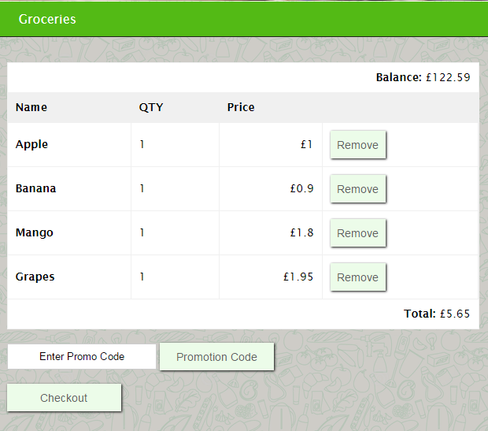
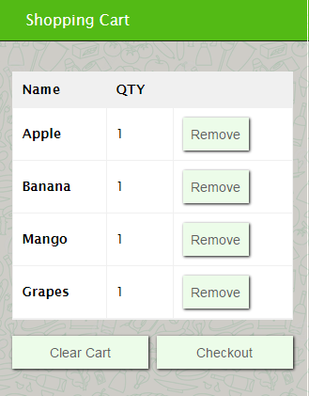
Head Core Developer
Sabba
Head Core Developer
Website Structure
Database Structure
Quality Assurance
Created Cart and Checkout code
Also created page system

Slide 5
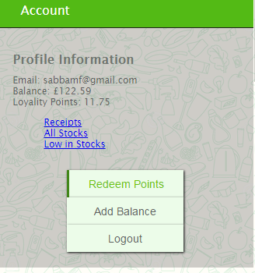
Payment
Loyalty Scheme
With the cart and checkout available, I have coded the payment module, how it works is it gathers the data from the checkout (item, item quantity and price) calculates the total and then checks the users balance to see if the user has sufficient funds
Payment coding is neat and uses SQL queries to complete the function which means that loyalty scheme and marketing (promotions) can be done through queries in that function.
With payment done, Loyalty scheme can be put into action, modifying the payment function in function.php by adding query to adjust points.
Created a button which allows to exchange points to balance

Slide 6
Project Manager
Akber
Overall responsibility for initiating, planning, design, execution, monitoring, controlling and finalising the project
The ability to ask penetrating questions
Chase up and confirm assumptions
Key roles – planning and setting up variables
Resourcing
Schedules
Managing issues
Leadership
Confidence and assurance

Slide 7
Supplier
Akber
Who is a supplier?
Manufacturer, distributor or a vendor
Can ship products to the supplier distribution hubs or directly to the retail store
Reliable and efficient
What is the role of a supplier?
Provide the products to resellers
The relationship between supplier and seller?
Is a very close relationship almost like a food chain between customer, seller and supplier
Responsibilities of a supplier?
Source the seller good products, material and supplier
What is EDI?
Electronic data integration – links databases, allows access between computer systems.
EDI is the best method and shows the trust between the supplier and seller
I am working on creating functions that will retrieve stock levels and update stock by requesting orders from the supplier.

Slide 8
Marketing
Abdala
Marketing is where a business creates new ways in which it can improve the performance of sales in hopes of increasing profit.
A business can do this by tracking consumer purchase, and by doing so can offer promotions and offers on popular products.
I approached this core by first researching the offers and promotions of other companies such as Tesco and Sainsbury for a better insight.
In doing so it has helped in deciding on offers and promotions that we will integrate into the software.

Slide 9
Marketing-Software :
Abdala
The promotions are advertised on the main page/home page
The customer will input the promo-code at checking out
The system checks with the database if the promotion Is available to them
If available another check is made to see if they meet the requirements for that specific promo.
If they meet the requirements the overall price is updated/discounted
Finally the customer pays and checks out with a discounted price.

Slide 10
Marketing: Tasks-to-do
Abdala
The promotions are limited – expand
Notifications alerting the customer on availability
Layout – in terms of visibility
Make design more user-friendly
Registration form needs changes based on the user interface.

Slide 11
Links
Abdala
www.shopping.fatanidev.com
https://github.com/ASA786/supermarket_app

Slide 12
Thank you for your time
Any Questions?

